Slide 1
6.4: Product-to-Sum and Su-to-Product Identities
MATH 1550 - Precalculus

Slide 2

Product-to-Sum Identities
$$\cos\left(A\right)\cos\left(B\right)=\frac{1}{2}\left[\cos\left(A+B\right)+\cos\left(A−B\right)\right]$$
$$\sin\left(A\right)\sin\left(B\right)=\frac{1}{2}\left[\cos\left(A−B\right)−\cos\left(A+B\right)\right]$$
$$\sin\left(A\right)\cos\left(B\right)=\frac{1}{2}[\sin\left(A+B\right)+sin⁡(A−B)]$$

Slide 3
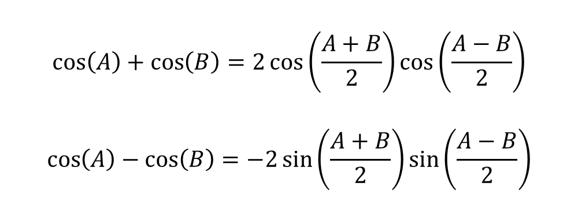
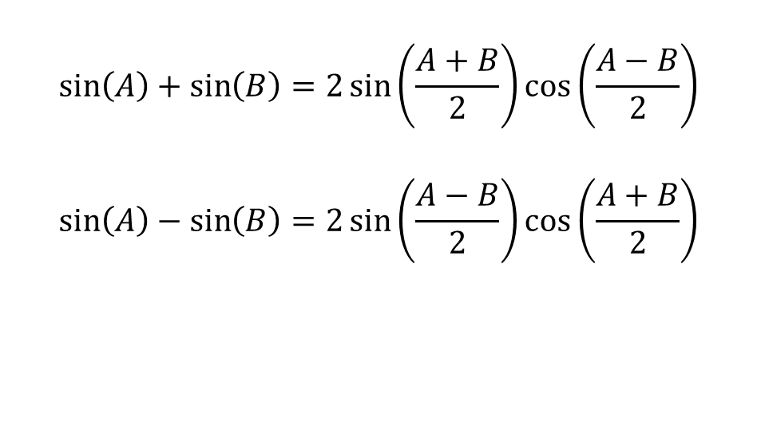
Sum-to-Product Identities
$$\sin\left(A\right)+\sin\left(B\right)=2\sin\left(\frac{A+B}{2}\right)\cos\left(\frac{A−B}{2}\right)$$
$$\sin\left(A\right)−\sin\left(B\right)=2\sin\left(\frac{A−B}{2}\right)\cos\left(\frac{A+B}{2}\right)$$
$$\cos\left(A\right)+\cos\left(B\right)=2\cos\left(\frac{A+B}{2}\right)\cos\left(\frac{A−B}{2}\right)$$
$$\cos\left(A\right)−\cos\left(B\right)=−2\sin\left(\frac{A+B}{2}\right)\sin\left(\frac{A−B}{2}\right)$$

Slide 4
6.5: Inverse Trigonometric Functions
MATH 1550 - Precalculus

Slide 5
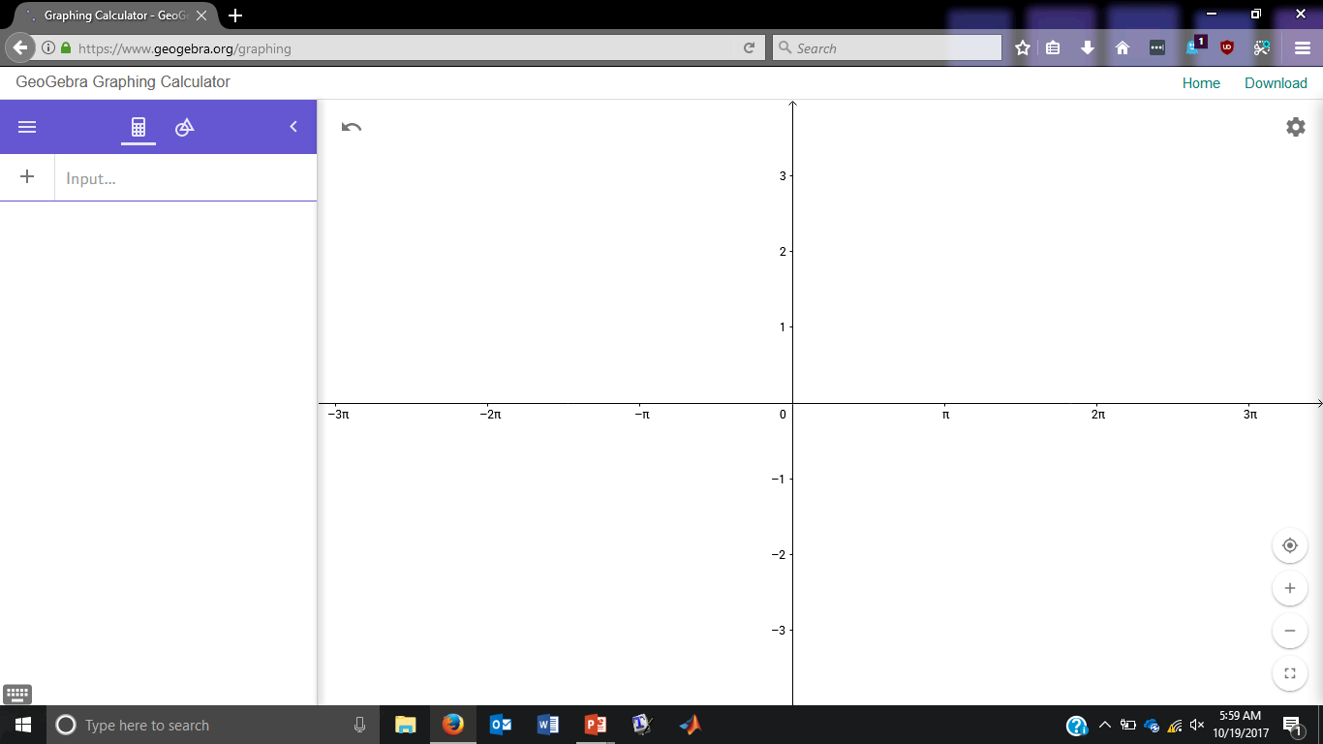

Does $y=sin⁡(x)$have an inverse over $ℝ$?
No! It fails the horizontal line test.

Slide 6
However, we can restrict ourselves to an area where the inverse would be defined!

Slide 7


$$−π/2$$
$$π/2$$
The horizontal line only crosses in one place over this region.

Slide 8
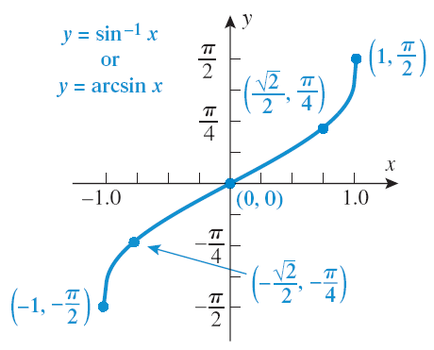

$$y = arcsin⁡(x)$$

Slide 9

We find the inverse function of $f(x) = cos⁡(x)$in a similar manner:

Slide 10

We find the inverse function for $f(x) = cos⁡(x)$in a similar manner.

Slide 11
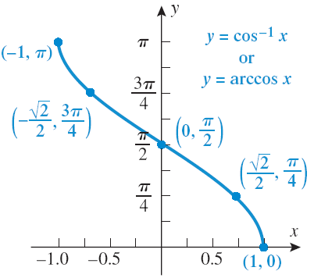

$$y = arccos⁡(x)$$

Slide 12
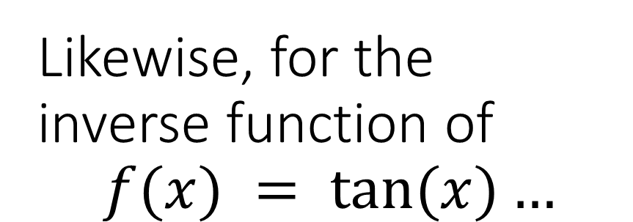
Likewise, for the inverse function of $$f(x) = tan⁡(x)…$$

Slide 13
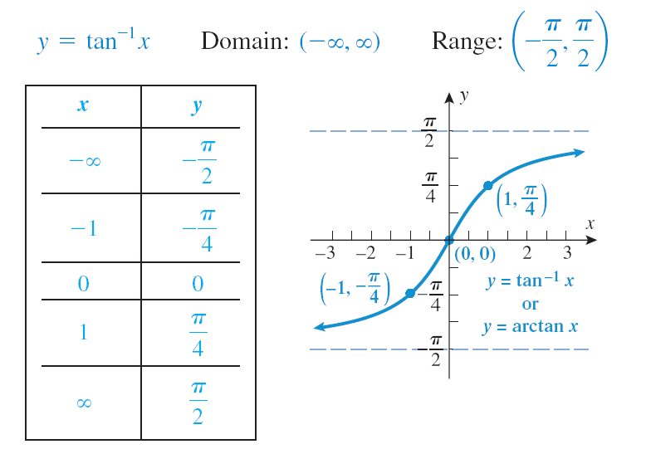

$$y = arctan⁡(x)$$

